Slide 1
KJM 3110 Electrochemistry
Chapter 7. Electrode reactions
2022

Slide 2
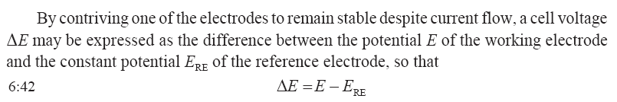



Ch. 6 Recap
Activities:
Concentrations and partial pressures:
ISEs utilise potentials over ion selective membranes:
After Ch. 6 you must be able to write a Nernst equation for the E_{n} (E_{Nernst}, OCV) of any half cell or full cell reaction!
And know the similar expression for a voltage over an ion selective membrane (ISE).

Slide 3
Status
Till now, we have been introduced to electricity, chemistry and thermodynamics, electrochemical cells and their operating modes, electrolytic cells (electricity to chemical energy) and galvanic cells (chemical energy to electricity).
We have started to look at electrodes.
We have in Ch. 6 looked at the thermodynamics of electrodes, and ways to describe it in tables and graphs.
We have looked at the use of thermodynamics in potentiometric electrodes, in particular ion selective electrodes (ISEs).
In Ch. 7 we’ll look closer at electrode reactions.

Slide 4
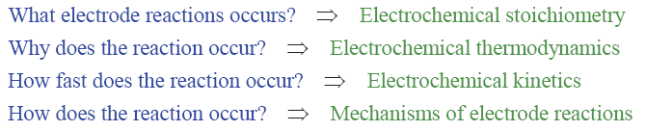
Electrode reactions
In chemistry (Ch. 2) one asks the following questions
In electrochemistry we may ask the same questions
Answers then emerge in electrochemical terms
In Ch. 7 – Electrode reactions – we address the two latter questions

Slide 5
Faraday’s law
What is Faraday’s law?
The amount (number of moles) of any substance produced or consumed in an electrode reaction is proportional to the quantity of charge passed
  Michael Faraday, 1832
  Faradaic currents
Non-faradaic currents: What may be their reasons?
Capacitive currents
Electronic conduction
Competing reactions

Slide 6


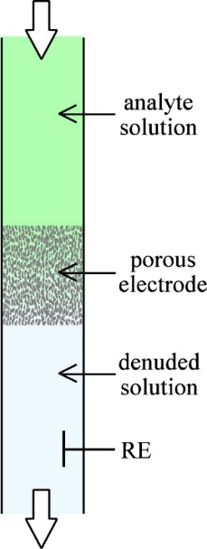
Coulometry
Coulometry
  Analysis of concentration c_{i} of a reactant species i in a finite volume V at fixed well-selected voltage
  The total charge converted is
    n and v_{i} are the number of electrons and molecules, respectively, involved in the reaction
  Charge Q is current I integrated over time t:
Flowing coulometry
  Limiting current at given flow and fixed voltage

Slide 7

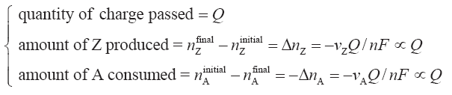
Reaction
General reaction
Sign of n signifies cathodic and anodic direction
Faraday’s law:

Slide 8
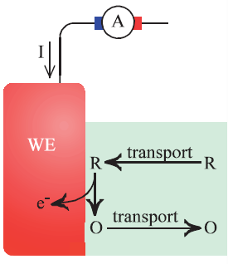
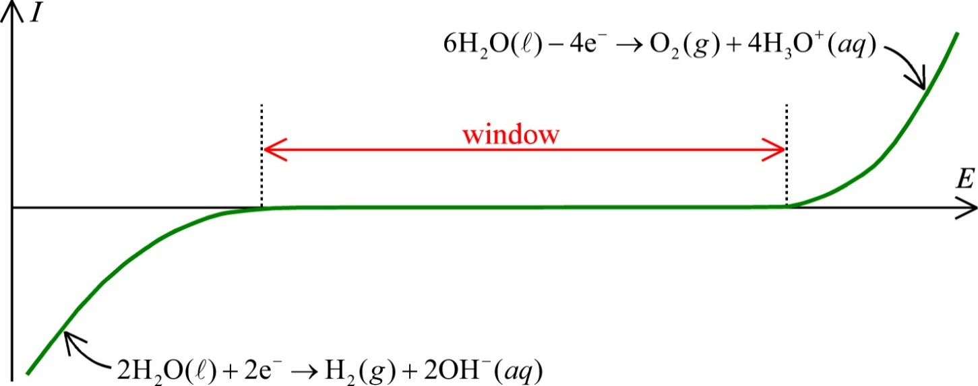
A sustainable electrode reaction of study or use must have …
An adequate supply of reactants
  Transport (mass transport)
An adequate removal of products
Sufficient kinetics of the electrode reaction
Conductive pathway for ions
  Supporting electrolyte
A potential window where the reaction (R = O + e⁻) dominates alone
  Where the electrode in the supporting electrolyte alone is polarized
  Example: Au in KNO₃(aq)

Slide 9
The Butler-Volmer equation
Now, the book takes us through a derivation of the BV equation.
It is as important as it is difficult, and there are as many versions and understandings as there are uses of it.
It is difficult to derive, and many approaches to making it simpler.
The book is one.
Let us first take a look at the end result - what we will derive. Can we understand it qualitatively and does it make sense even before we do it in more depth?

Slide 10

A closer look at the reaction
or just R ↔ e⁻ + O
Transport may give gradients
We differentiate concentrations c of Reduced and Oxidised species in bulk (b) and on the electrode surface (s).
c_{R}^{s}
c_{R}^{b}
c_{O}^{s}
c_{O}^{b}

Slide 11
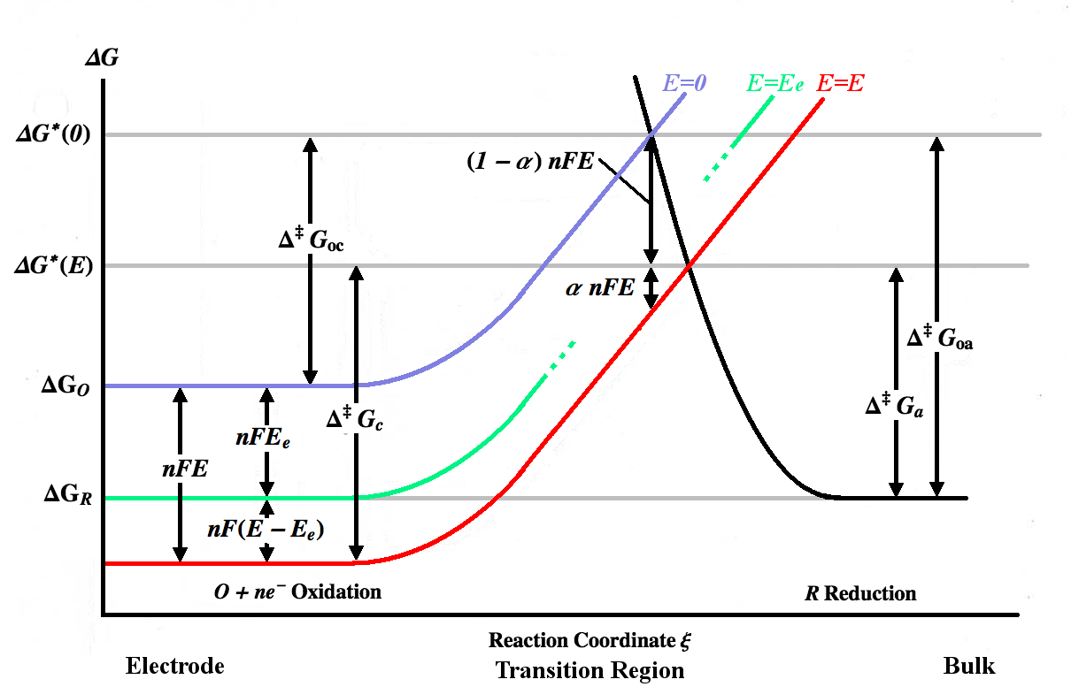
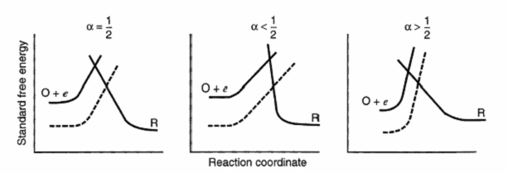
The energy barrier
R ↔ e⁻ + O
Reaction coordinate
Gibbs energies
  Reactant
  Product
  At i = 0 (equilibrium) balanced by
    nFE⁰ (standard conditions)
    nFE_{e} (general)
  Altered by nF(E-E_{e})

Slide 12


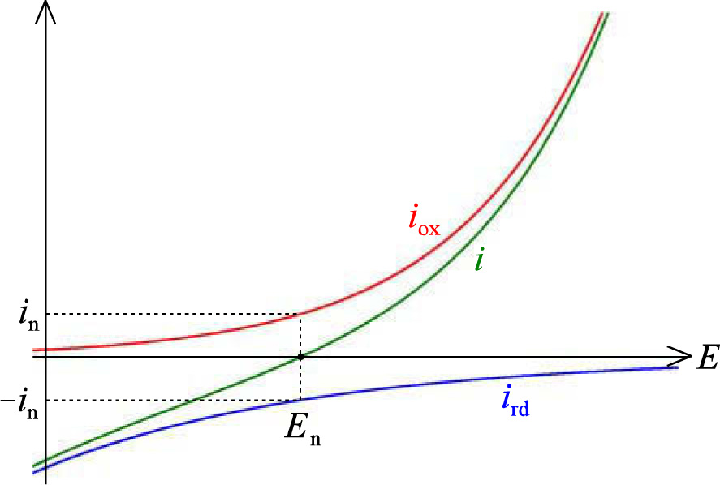
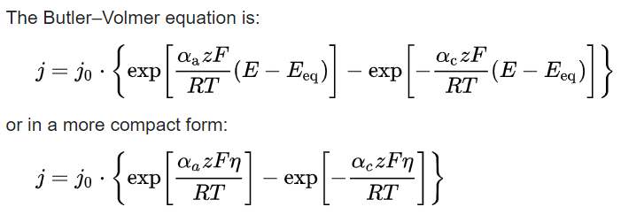
Kinetics of electrode reaction – Butler-Volmer
Simplest possible oxidation reaction
Butler-Volmer:
The net current density is the sum of the positive oxidation and negative reduction currents
s = surface
b = bulk
Which terms do we understand?
Which don’t we understand?

Slide 13



Kinetics of electrode reaction – rate and current
For single electron transfer we will now derive the Butler-Volmer equation
Simplest possible oxidation reaction
Net forward oxidation reaction rate
Net current density
Definition: An anodic current (oxidation) flowing into a WE is positive.
Oxidation rate
(All potential dependent)
Reduced species
Oxidised species

Slide 14
Check
What are the units of the variables in the equations on the last slide?
What determines k_{ox}?
Why and how does it vary with E?

Slide 15





Kinetics of electrode reaction - equilibrium
Simplest possible oxidation reaction
Oxidation rate
Reduction rate
Substitute into the net current density:
At equilibrium (open circuit) we have zero current, and the null voltage, and the surface concentrations become equal to the bulk concentrations:
Nernst: becomes

Slide 16
Check
What are E_{n} (the null, or open circuit, or equilibrium potential) and E°’ (the “formal” potential) exactly?
What is the significance of the prime (‘) throughout here?
We have seen that the mass action quotient Q can be expressed by different parameters, like
  Activity, or concentration
  Rate constants
  More?
Discuss how this works for normal chemical reactions and for electrochemical reactions.

Slide 17


Kinetics of electrode reaction – formal rate constant
Simplest possible oxidation reaction
Nernst: becomes
Similar for any potential:

Slide 18

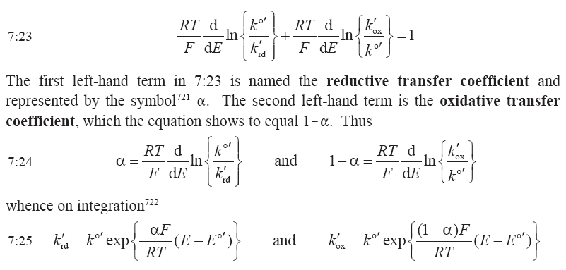
Kinetics of electrode reaction – transfer coefficients
Simplest possible oxidation reaction
Rearrange to
Multiplying with k^{0’}/k^{0’} and dropping (E)…
Differentiating w.r.t. E:
Also called symmetry factors or charge-transfer coefficients

Slide 19

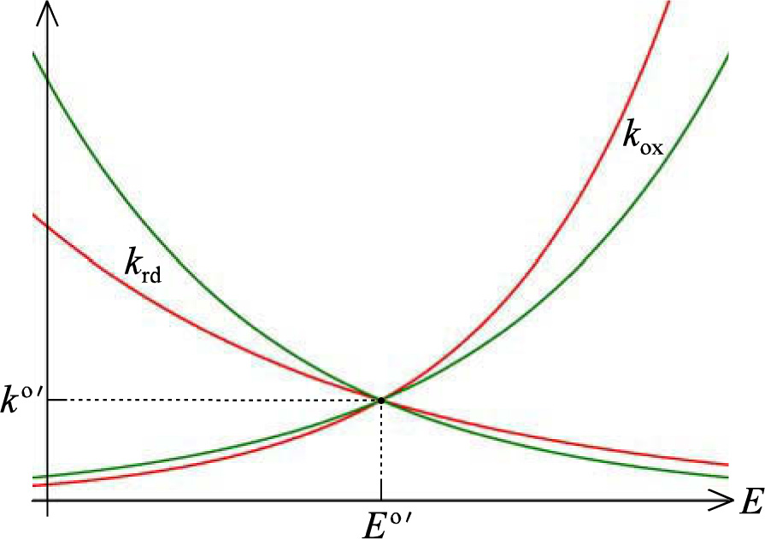
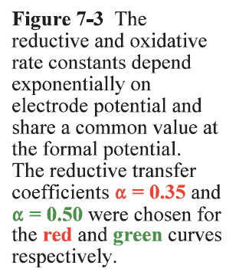
Kinetics of electrode reaction – transfer coefficients
Simplest possible oxidation reaction
Rate constants at open circuit voltage E vs formal open circuit voltage E°’

Slide 20
Symmetry of the energy barrier
Reductive and oxidative transfer coefficients
Charge transfer coefficients
Symmetry factor

Slide 21
Kinetics of electrode reaction – Butler-Volmer
Simplest possible oxidation reaction
Substitution of
Into
Yields one version of the Butler-Volmer equation:
Alternative:

Slide 22
Forms of the BV equation – all provide the same i
Relates to the formal potential:
Relates to the null potential:
Wikipedia:
Note the z
Note the η

Slide 23
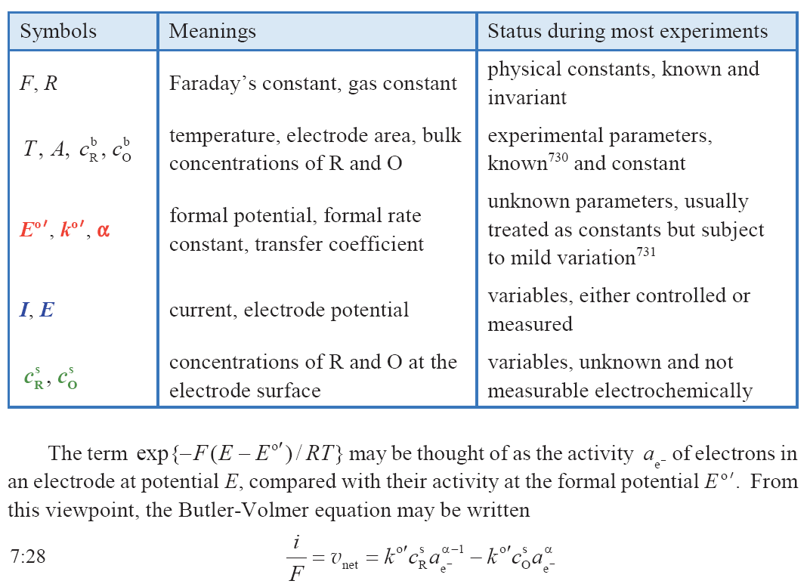

Slide 24

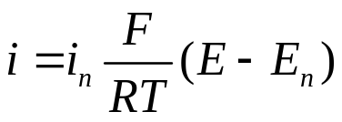
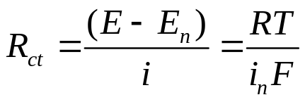
Kinetics of electrode reaction – Butler-Volmer
Simplest possible oxidation reaction
Butler-Volmer:
At E ≈ E_{n}, the BV equation linearises to
Rearranged into charge transfer resistance:

Slide 25
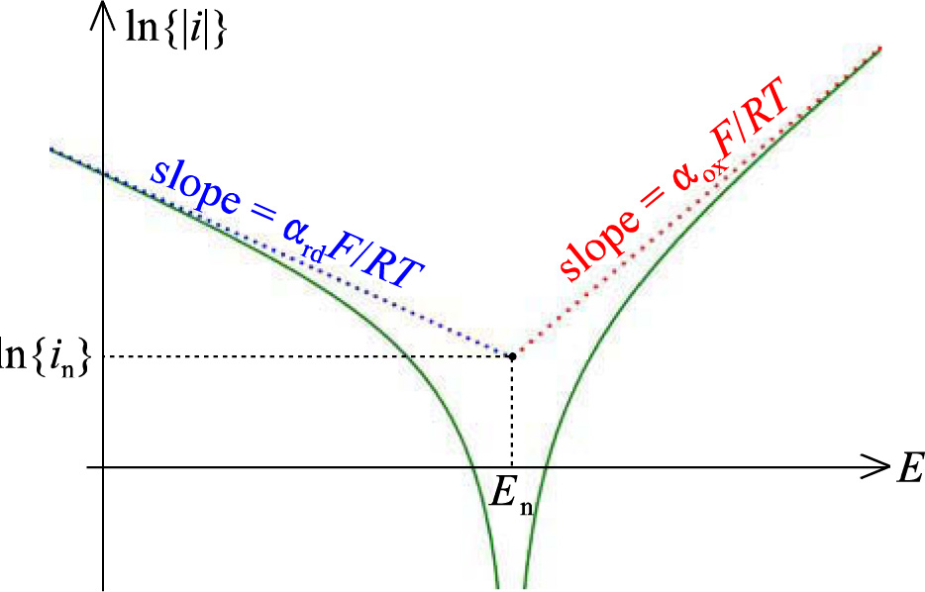
Tafel plot
ln|i| or log|i| vs E
At large potentials, the oxidation or reduction dominates
The current becomes exponentially dependent on E
α_{rd} = α|z|
α_{ox} = (1-α)|z|
z = number of electrons

Slide 26


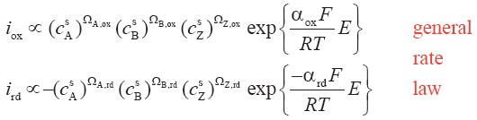
Reaction order
Example reaction
For reactant A, for reduction,
General rate law
Curriculum stops after this Eq. 7.40

Slide 27

Summary Ch 7. Electrode reactions
Butler-Volmer equation
I-E (or I-V or I-U or Butler-Volmer) plot Tafel plot

