Slide 1


Slide 2
Educational Attainment: Level of education completed by an individual.
Genetic Predisposition to Depression: Investigating specific genetic variations known to be associated with depression.
Season of Birth: Some studies suggest that individuals born in certain seasons may have a higher likelihood of developing depression due to factors like vitamin D exposure.
Early Life Stressors: Early life stressors such as loss of a parent or severe economic hardship can increase the risk of later-life depression.
Dietary Habits in Midlife: This includes the type of diet followed during midlife, focusing on elements known to affect brain health, such as omega-3 fatty acids.
Please provide a list of five "instruments" that can be used to investigate whether there is a causal influence of depression on the risk for dementia using instrumental variable regression. Make sure the list contains both good and poor instruments, but don't tell me which is which, I would like to figure that out together with my students.
Notes:
Evaluate Instrument Strength:
"Discuss the criteria for a strong instrument in Mendelian randomization studies and apply these to evaluate the instruments provided."
Assess Instrument Validity:
"What are the key assumptions for a valid instrument in IV regression, and how can we test whether these assumptions hold for each instrument listed?"
Explore Pleiotropy:
"Consider the possibility of pleiotropy in the instruments listed. How could pleiotropy affect the validity of the instruments and the results of the Mendelian randomization?"
Compare Instruments:
"Compare and contrast the potential instruments in terms of their relevance and exogeneity. Which characteristics might disqualify an instrument, and why?"
Design a Study:
"Design a hypothetical study using one of the instruments to investigate the causal effect of depression on dementia risk. Outline the study design and the statistical analysis plan."
Instrumental Variable Estimation:
"How does the instrumental variable estimation differ from the traditional regression analysis? Discuss the implications of this difference in the context of the provided instruments."
Data Sources and Quality:
"What are the potential sources of data for the instruments listed, and how might data quality issues impact the study's findings?"
Ethical Considerations:
"Are there any ethical considerations to be aware of when using genetic instruments for Mendelian randomization studies?"
Instrument Selection Strategy:
"What strategies could be used to select the most appropriate instrument from the list for a Mendelian randomization study?"
Discuss Confounding and Bias:
"How do instrumental variables help to address confounding and bias in observational studies? Provide examples with the instruments listed."

Slide 3
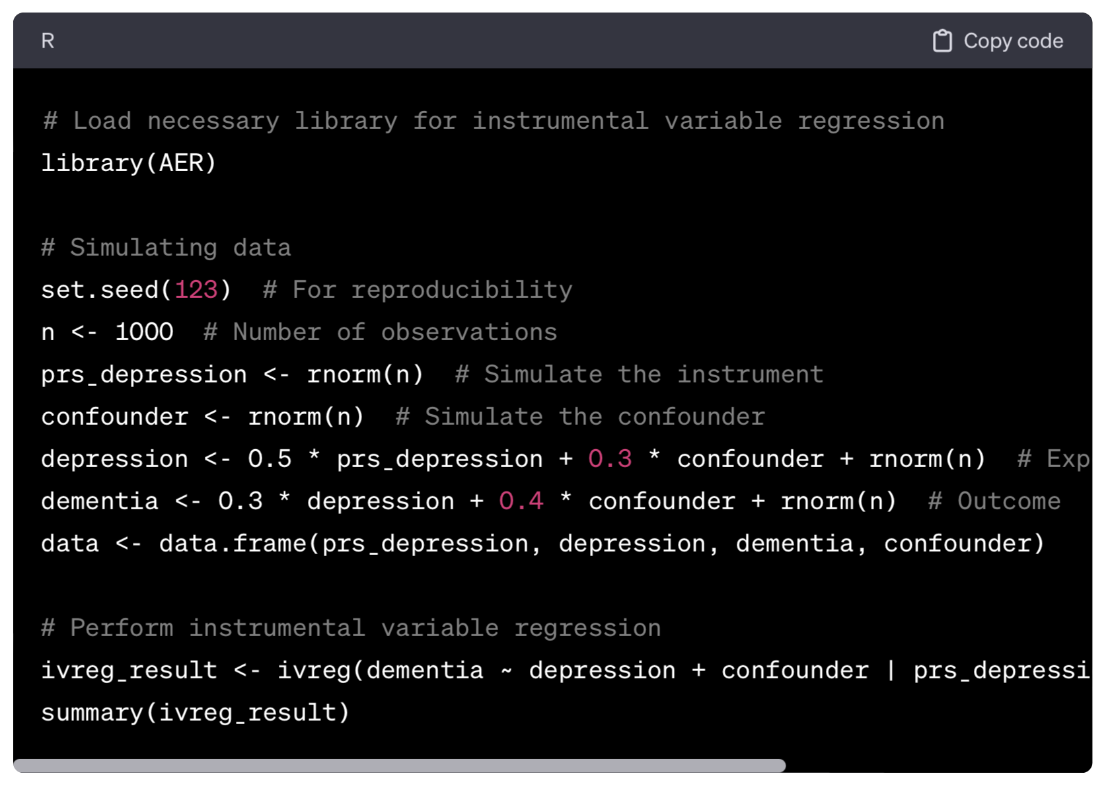
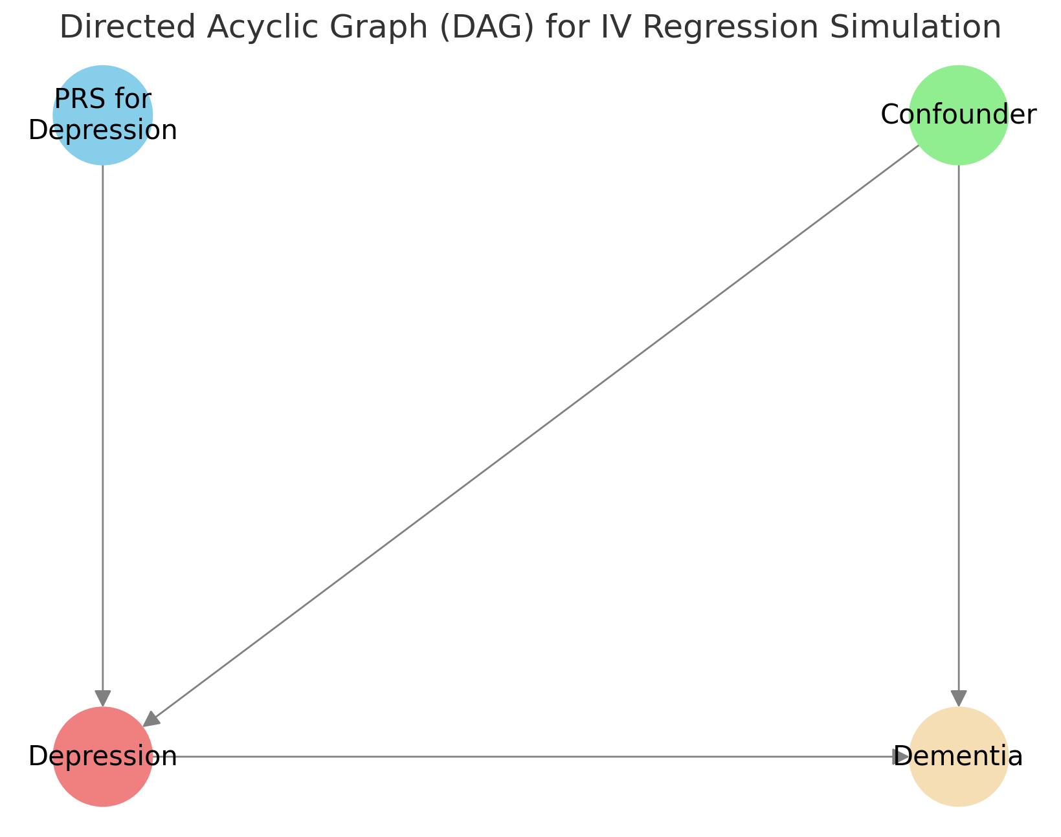
Please output R code to simulate data for an instrumental variable regression in R. Assume the instrument is the polygenic risk score for depression.
Notes:
Vary the Strength of the Instrument:
Prompt: "Adjust the strength of the PRS for depression as an instrument by changing the coefficient in the simulation. Observe how this affects the estimates and diagnostics in the IV regression."
Introduce Measurement Error:
Prompt: "Simulate measurement error in the PRS for depression and examine how this impacts the IV regression results. Discuss the implications for using genetic instruments."
Change the Confounder's Impact:
Prompt: "Alter the influence of the confounder on both depression and dementia. Analyze how varying degrees of confounding affect the bias in the estimates."
Simulate Non-Linear Relationships:
Prompt: "Modify the simulation to include non-linear relationships between variables. Explore how IV regression handles non-linearity in the context of Mendelian randomization."
Test Different Sample Sizes:
Prompt: "Experiment with different sample sizes in your simulation. Discuss how sample size affects the power and precision of IV estimates."
Introduce Additional Confounders:
Prompt: "Add more confounders to your simulation. Investigate the impact of multiple confounding factors on IV regression results."
Explore Different Distributions of Variables:
Prompt: "Change the distributions of your simulated variables (e.g., make them skewed or kurtotic). Explore how the distributional assumptions affect the results."
Use a Different Instrument:
Prompt: "Simulate a different instrument for depression, such as a different genetic variant or a composite genetic score. Compare the results with those obtained using PRS for depression."
Simulate Binary Outcomes:
Prompt: "Modify the outcome (e.g., dementia) to be a binary variable. Discuss the challenges and methods for IV regression with binary outcomes."
Conduct Sensitivity Analysis:
Prompt: "Perform sensitivity analyses to check the robustness of your IV estimates to violations of key assumptions like the exclusion restriction."
Compare with Other Methods:
Prompt: "Compare the IV regression results with estimates obtained from other methods like ordinary least squares (OLS) or logistic regression."
Examine Effect Heterogeneity:
Prompt: "Investigate whether the effect of depression on dementia varies across different subgroups in your simulated data."
Assess Instrument Validity:
Prompt: "Implement statistical tests or checks to assess the validity of your instrument."

Slide 4
Please make a Quiz to probe students understanding of this R-output
> summary(ivreg_result)
Call:
ivreg(formula = dementia ~ depression + confounder | prs_depression +
confounder, data = data)
Residuals:
Min 1Q Median 3Q Max
-3.12293 -0.62490 0.00296 0.66521 2.90888
Coefficients:
Estimate Std. Error t value Pr(>|t|)
(Intercept) -0.008942 0.031463 -0.284 0.776
depression 0.294971 0.066494 4.436 1.02e-05 ***
confounder 0.394943 0.039606 9.972 < 2e-16 ***
Diagnostic tests:
df1 df2 statistic p-value
Weak instruments 1 997 233.069 <2e-16 ***
Wu-Hausman 1 996 0.587 0.444
Sargan 0 NA NA NA
---
Signif. codes: 0 ‘***’ 0.001 ‘**’ 0.01 ‘*’ 0.05 ‘.’ 0.1 ‘ ’ 1
Residual standard error: 0.9936 on 997 degrees of freedom
Multiple R-Squared: 0.2851, Adjusted R-squared: 0.2837
Wald test: 140.6 on 2 and 997 DF, p-value: < 2.2e-16 "
Quiz Questions:
What does the coefficient for 'depression' indicate in this model?
  A. It represents the change in dementia for each unit increase in depression.
  B. It shows the effect of the confounder on dementia.
  C. It indicates the relationship between PRS for depression and dementia.
  D. It is the direct effect of dementia on depression.
What do the results of the 'Weak instruments' diagnostic test suggest?
  A. The instrument is weak and not suitable.
  B. The instrument is strong and suitable for the analysis.
  C. The test is inconclusive.
  D. The test does not apply to this model.
Notes:
Quiz Questions:
What does the coefficient for 'depression' indicate in this model?
A. It represents the change in dementia for each unit increase in depression.
B. It shows the effect of the confounder on dementia.
C. It indicates the relationship between PRS for depression and dementia.
D. It is the direct effect of dementia on depression.
Is the relationship between depression and dementia statistically significant?
A. Yes, it is highly significant.
B. No, it is not significant.
C. The results are inconclusive.
D. The significance cannot be determined from this output.
What do the results of the 'Weak instruments' diagnostic test suggest?
A. The instrument is weak and not suitable.
B. The instrument is strong and suitable for the analysis.
C. The test is inconclusive.
D. The test does not apply to this model.
What can be inferred from the Wu-Hausman test result?
A. There is strong evidence of endogeneity.
B. There is no evidence of endogeneity.
C. The test is inconclusive regarding endogeneity.
D. The test suggests the model is mis-specified.
How would you describe the model’s overall explanatory power based on the 'Multiple R-Squared' value?
A. The model explains a very high proportion of the variability in dementia.
B. The model explains a moderate proportion of the variability in dementia.
C. The model explains a low proportion of the variability in dementia.
D. The model does not explain any of the variability in dementia.
Correct Answers:
A
A
B
B
B

